Slide 1
Gephi Tool
Social Network Analysis

Slide 2
Introduction
Gephi is a visualization application developed in the Java language.
It is mainly used for visualizing, manipulating, and exploring networks and graphs from raw edge and node graph data.
It is a free and open-source application. It is built on the top of the Netbeans Platform and uses OpenGL for its visualization engine.
It runs on Windows, Mac OS X, and Linux. It is an excellent tool for data analysts and data science enthusiasts to explore and understand graphs.
It is similar to Photoshop but deals with graph data.
The user interacts with the representation, manipulates the structures, shapes, and colors to reveal hidden patterns.
The primary goal is to enable the user to make a hypothesis, discover hidden patterns, isolate structure singularities and defects during data sourcing.

Slide 3
What is Gephi good for?
Gephi is good for beginners in network analysis.
The point-and-click software can handle basic and advanced network analytics and customizable graph visualizations.
One can analyze network structures, communities, and key actors, and can design network graphs on static and dynamic networks, geo-located data, as well as multimode/multiplex networks.
However, Gephi is more limited analytically than software available in programming, such as R or Python.

Slide 4
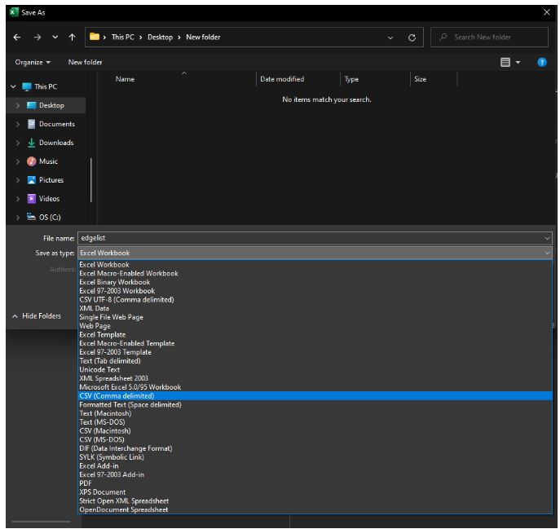
Data files
Data should be organized in two spreadsheets:
(1) edgelist, (2) node attributes.
These files work best if saved as .csv.

Slide 5
Data files
The edgelist contains a minimum of two columns:
(a) Source (b) Target.
Any relevant edge attribute can be added (e.g., Date, Type, etc.).
Source is the respondents, Target is the nominated individuals.
Of course, some people will be both a Source, when they nominate others and a Target, when they are nominated by other respondents.
One row in the spreadsheet will mean one interaction between two people, A and B.

Slide 6
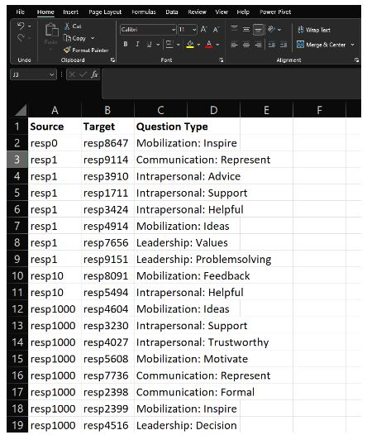
Data files

Slide 7
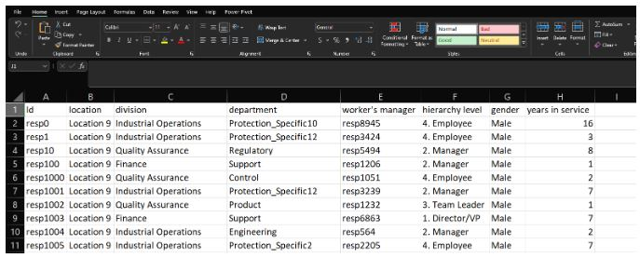
Data files
The node attributes file contains the node IDs (unique identifiers) and the characteristics of the people (e.g., hierarchy level, location, business unit, department, gender, years in service, etc.).

Slide 8
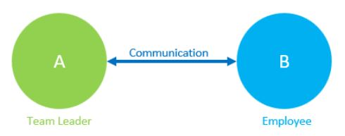
Data files
We will use the edge weight to show, with the thickness of the link, the strength of the relationship between two people at work, and we will use the node attributes to color the nodes according to specific characteristics (e.g., different colors for gender, location or hierarchy level).

Slide 9
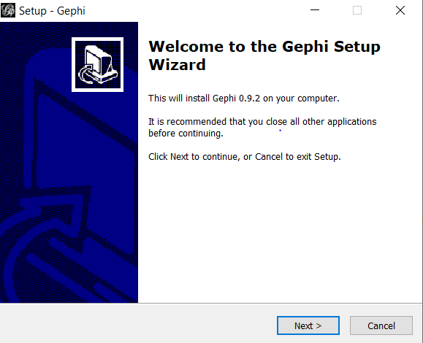
Installing Gephi
Step 1: Before downloading Gephi, ensure that the latest version of Java JRE is installed on your system. If not, first download it from here. Step 2: Go to the official website of Gephi, and click on Download Now. Step 3: Click on the appropriate option accordingly for Downloading Gephi either on Windows, Mac, or Linux. Step 4: Let the download complete, then run the installer.

Slide 10
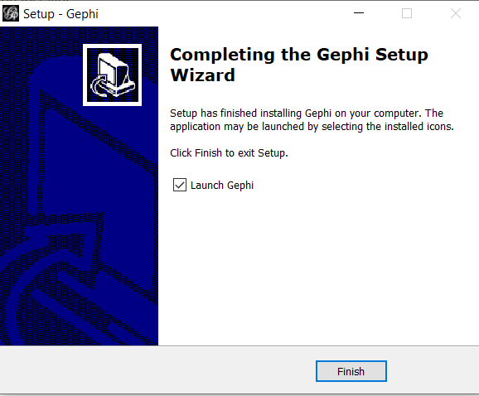
Installing Gephi
Step 5: Keep Clicking Next and follow the steps. Step 6: After the installation is complete, click on Finish.

Slide 11
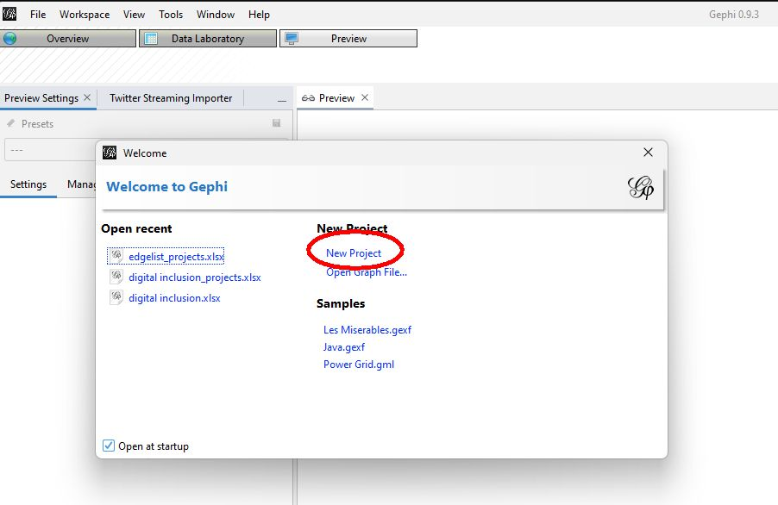
Add data to Gephi
Once installed and opened, you’ll get a first pop-up window:

Slide 12
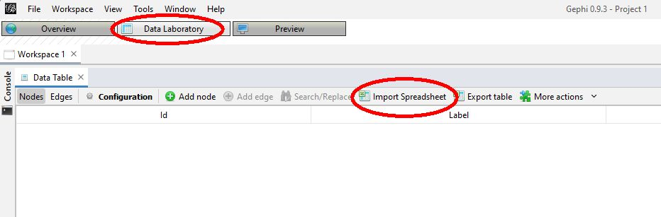
Add data to Gephi
Click New Project, to activate the Data Laboratory Tab.

Slide 13
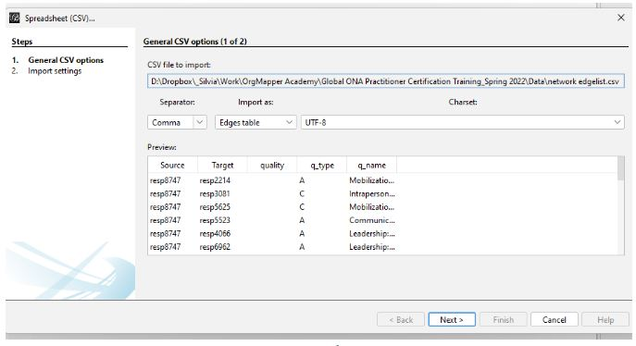
Add data to Gephi
Click on Data Laboratory and then on Import Spreadsheet. If you have a missing Data Table window, like the one shown in the screenshot above, go to the main menu: Window 🡪 Data Table, and then the Import Spreadsheet button should be available.

Slide 14
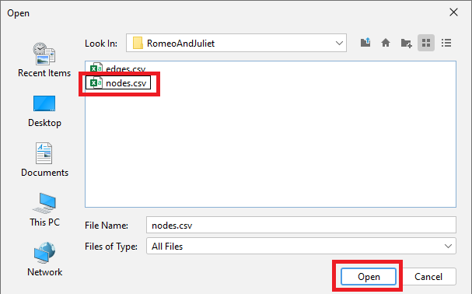
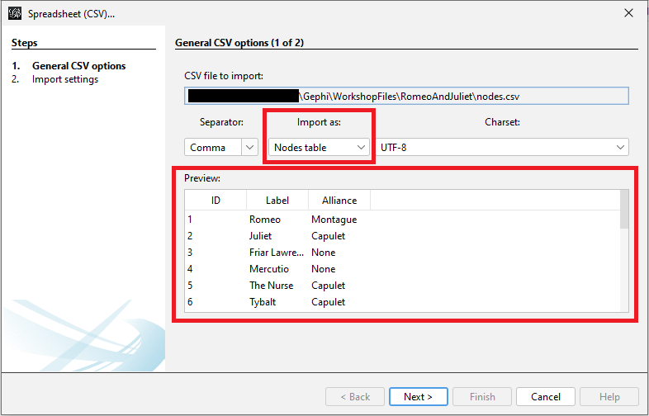
Add data to Gephi

Slide 15
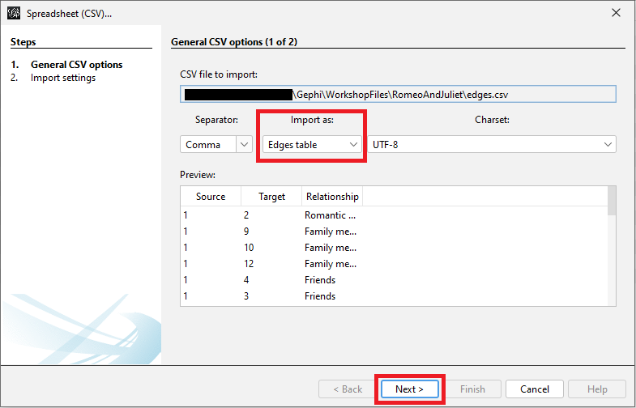
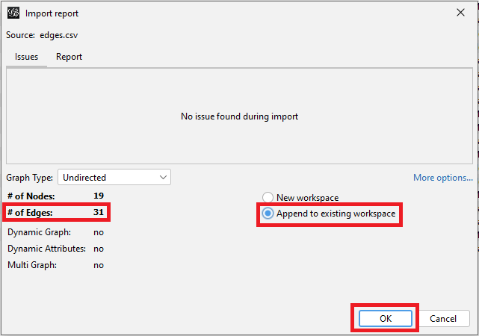
Add data to Gephi

Slide 16
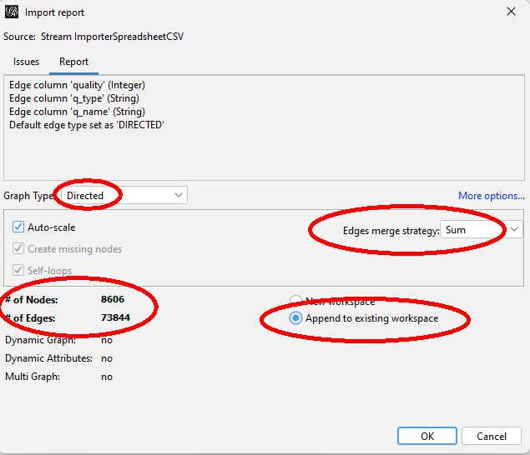
Add data to Gephi
In the figure, pay attention to the following: whether Gephi recognizes your network as directed or undirected. Check if the number of nodes and edges seem correct. Choose the edge merge strategy i.e., if you have one person nominating the same person on each question, Gephi will add (using Sum) the number of nominations A gave to B. Choose append the existing workspace, to add data in the workspace opened.

Slide 17
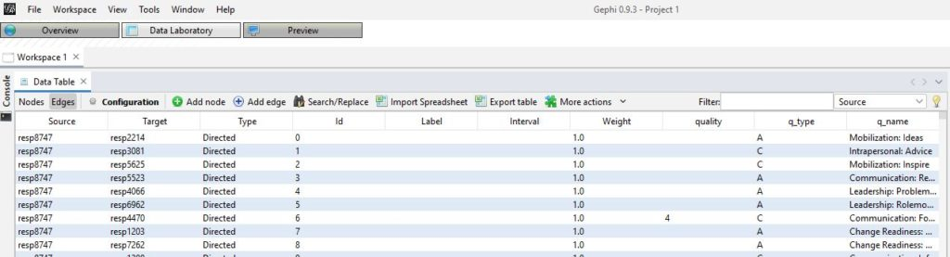
Add data to Gephi
Preview of the edgelist imported into Gephi (Edges Tab)

Slide 18
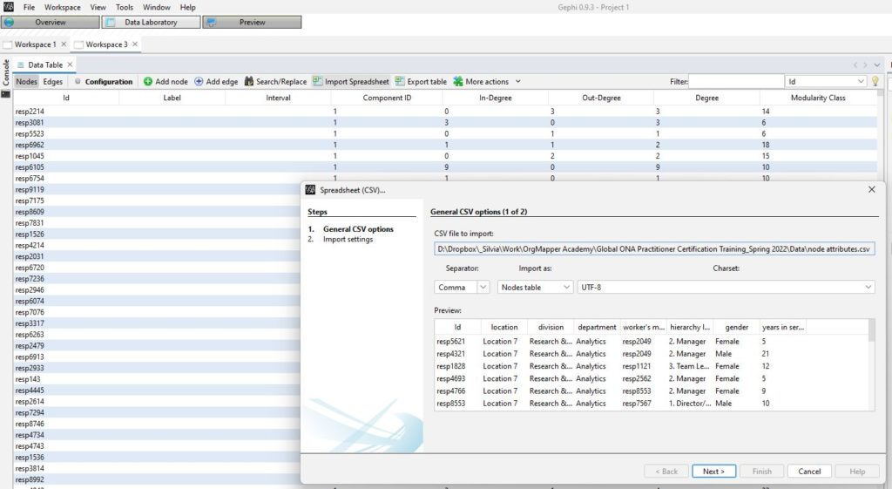
Add data to Gephi
To import the node attributes file, go to Data Laboratory 🡪 Import Spreadsheet 🡪 Choose node attributes file.

Slide 19
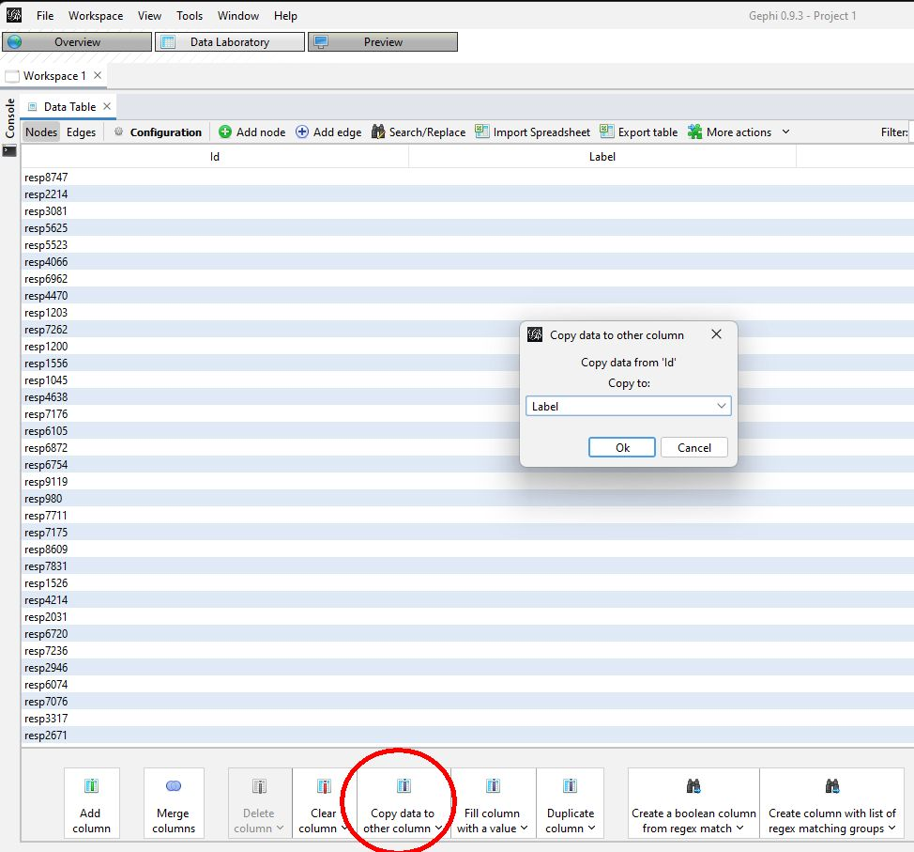
Add data to Gephi
To add labels to the nodes, follow the steps: In Data Table, click on Nodes 🡪 Copy Data to Other Column 🡪 Choose Id 🡪 Choose Label 🡪 press Ok

Slide 20
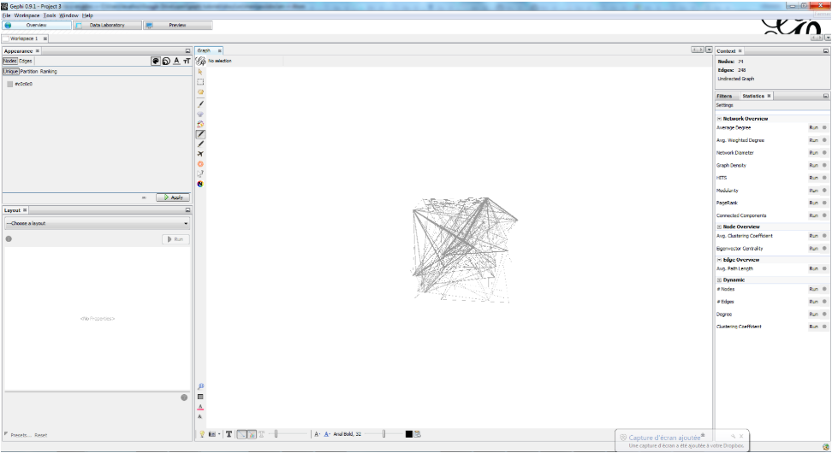
Let's start visualizing
Click on "Overview" to see your graph.
If you do not see your graph, click on "window" and then click "graph." This will populate a window for your graph.

Slide 21
Let's start visualizing
What is that?
The initial visualization you see won't look like much, but don't worry! There are three ways we can explore and improve this graph:
1. Overview: We can explore the graph visually
2. Data Laboratory: This is where we can see the spreadsheet view of our data -- and the new data we create as we analyze our graph
3. Preview: This is where we polish our visualization.

Slide 22
Ways to find out information from your graph
Here are a few ways you can explore and visualize your data:
Layout
Gephi adjusts the nodes and edges in the network by the layout feature. It prioritizes different properties of the network.
Choose a layout from the drop-down list (e.g., ForceAtlas 2)
Adjust parameters for the layout algorithm
Click the "Run" button
Continue to refine the layout until you are happy with the results
Color
Select a "partition" (categorical) node variable from your data. For example, in our sample data in the Gephi workshop we have the variable called "State"
Click on "Partition"
Click on "Nodes"
Choose "State" from the drop down
Click "Apply"

Slide 23
Ways to find out information from your graph
Filter
Click the "Filters" tab on the right
Expand the "Attributes" folder
Double-click the "Equal" folder
Drag “sex” down to the “Queries” below.
Click the "Filter" button
Size
i) Resize nodes uniformly
Click on the selection box icon on the left vertical toolbar
Draw a box around all nodes to select them all
Click on the diamond icon on the left vertical toolbar
Click on a node, then drag the mouse up and down to increase and decrease the size

Slide 24
Ways to find out information from your graph
ii) Resize nodes according to a numerical variable
Click on the "Ranking" tab
Click on "Nodes"
Select a variable (e.g., Degree) from the drop down Choose a minimum and maximum size as a range for the size of the nodes
Click the "Apply" button

Slide 25
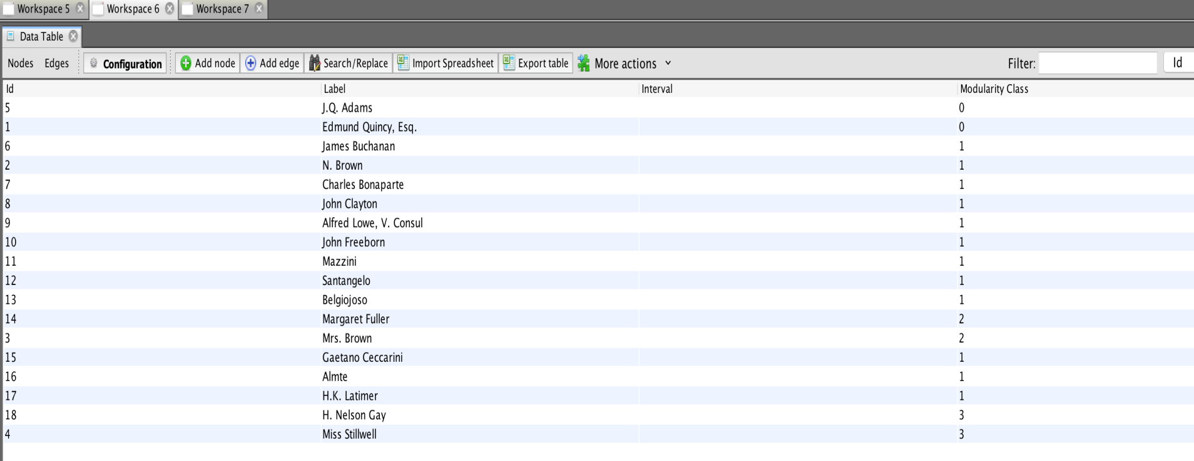
Ways to find out information from your graph
Statistics
Click the Statistics tab on the right hand side
Run the “modularity” statistic as a first example.
This creates a new way to view your graph. It also populates a new cell in your data laboratory.
Click into the “Appearance” tab on the left-hand side. Under “nodes” click “modularity class” in the “Partition” tab.

Slide 26
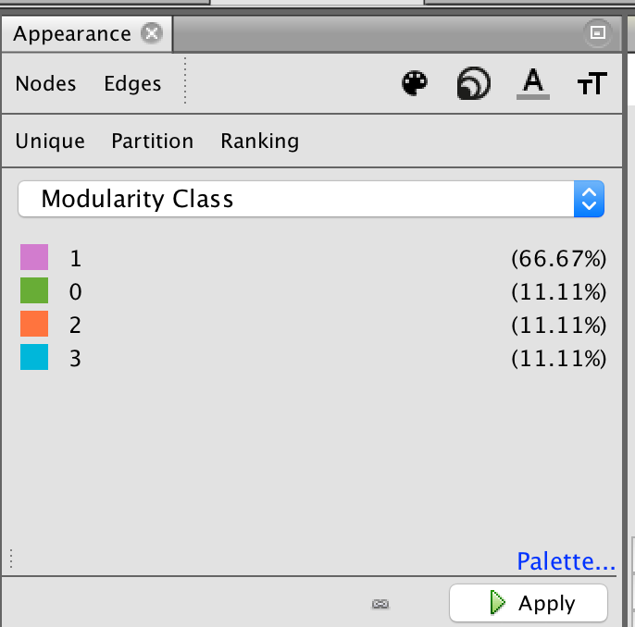
Ways to find out information from your graph
Color your nodes by community
Once you've calculated modularity, we can color nodes according to their communities. Go to the Partition pane (on the left side of the Gephi window) and click on the little Refresh icon. From the dropdown window, select Modularity Class.

Slide 27
Save your graph and share it
If you'd like to open your file again in Gephi, you can save it as a Gephi file.
You can also take a screenshot from the Overview panel by clicking on the camera.
When you're satisfied with your image, you can export the file as an SVG/PDF/PNG file.

Slide 28
Advantages of Gephi
Extremely Fast: It is built using the OpenGL engine. So Gephi allows us to with very large networks with very high speed. It can visualize networks up to a million elements. All the actions such as layout, filter, and drag run in real-time.
Simple: It is very easy to install and get started with. It is best known for its window interface. It has a very easy interface to use and is filled with handy tools
Modular: The Gephi software is split up into different modules. All its features are wrapped into separated modules. Each module provides a specific function, which makes the maintenance of the software a lot easier.
Easy Data Import: The data import process is very easy in CSV format.

Slide 29
Disadvantages of Gephi
There is absolutely no linking between views.
There are a few visual glitches
The navigation of the Graph can be improved.

Slide 30
Applications of Gephi
It is used in exploratory data analysis and makes analysis by manipulating the networks in real-time.
It is used to represent patterns of biological data.
It is used to create posters and promote scientific work using high-quality maps that are printable too.

